Slide 1
Blockchain Build Cookbook
Blockchain

Slide 2
The goal of the practical sessions is to create an offline Blockchain application.
C# is used and resources such as the template code are in C#
Visual Studio is the recommended IDE for developing in C#,
All you need: the instructions here and the visual studio project which will provide the template code for this coursework plus you have the videos of incremental coding and its fully commented listing that you can copy into your own version of the visual studio project code to be expanded during the next 5 sessions.
The project template uses Windows Forms for the UI with ready-made classes to be used to set up the buttons with text boxes and the screen messages as the windows into the workings of your mini-blockchain

Slide 3
 | Evidence of implementation | Report | Total
Part 1 – Project Setup | 3 | 2 | 5
Part 2 – Blocks and the Blockchain | 5 | 5 | 10
Part 3 – Transactions and Digital Signatures | 5 | 5 | 10
Part 4– Consensus Algorithms (Proof-of-Work) | 10 | 10 | 20
Part 5 – Validation | 10 | 10 | 20
Part 6 – Assignment Tasks | 15 | 20 | 35
Practical Guided Exercises as 65% of your Coursework Assignment | 48 | 52 | (100)

Slide 4
Your mini Blockchain is to be made of cryptographically connected components through the following stages:
Blocks and wallets set up and initialisation
Transaction generation – including digital signature via asymmetric encryption;
A Proof-of-Work consensus algorithm – including hashing and threading;
Validation methods to ensure the Blockchain is valid;
A basic UI that can verify the implementation of the above features.

Slide 5
Part 1 – Project Setup
Have the following 12- Resources on your desktop /Laptop
This Cookbook PowerPoint -from CS3BC on BB via:
Teaching Materials -> Coursework Support Materials -> Blockchain Assignment Development Resources
2) Blockchain Project.zip – From CS3BC BB via
Teaching Materials -> Session 1 Introduction to Blockchain -> Practical’s and Supporting Materials -> Blockchain Project.zip
3) Blockchain Lab Practical Guided Exercises to Support the Coursework Assignment –from CS3BC on BB via
Teaching Materials -> Coursework Support Materials -> Blockchain Assignment Development Resource
4) Visual Studio https://visualstudio.microsoft.com/vs/community
5) Download the Blockchain Assignment Project -from CS3BC on BB via:
Blockchain Project.zip Teaching Materials -> Session 1 Introduction to Blockchain –> Practical’s and Supporting Materials -> Blockchain Project.zip
6) Online Tutorials Video Part 1: Project Set-up - Accessible through the (Yuja Channel) on CSMBD BB

Slide 6
7) The Blockchain build FlowChart -from CS3BC on BB via:
Teaching Materials -> Coursework Support Materials -> Blockchain Assignment Development Resources
8) Highlighted Code: - from CS3BC on BB via:
Teaching Materials -> Coursework Support Materials -> Blockchain Assignment Development Resources
9) Highlighted Lab Script - from CS3BC on BB via:
Teaching Materials -> Coursework Support Materials -> Blockchain Assignment Development Resources
10) Further Coursework Support – Hints and Tips -from CS3BC on BB via:
Teaching Materials -> Coursework Support Material -> Coursework Support
11) Further Coursework Support – CS3BC -from CS3BC on BB via:
Teaching Materials -> Coursework Support Material -> Coursework Support
12) Setting up your Repository for your project -from CS3BC on BB via:
Teaching Materials -> Coursework Support Material -> Coursework Support

Slide 7
Now Let’s start off your very own mini blockchain build towards 100% in the coursework - Learning by Doing through the 13 steps below
Logical Sequence of steps to sail through this mini blockchain build as 65 percent of your coursework complete-able in just a few hours .
1) Locate and access all the above 12 items on BB using the paths given above and download them, on your machine.
2) Launch the Visual Studio on your machine.
3) Scan the highlighted Blockchain code Flow Chart.
4) Examine the entire micro-commented code guided by the highlighting to see how the evolution of different parts of the code took shape through additional class declarations and methods that had to be added in the relevant parts of the Block.cs and elsewhere for the UI to code up for each part-build, display it and to make sure all parts are integrated and results displayed and thus validated.

Slide 8
5) Now concentrate on Part 1 of the build by examining the code for Part-1 including the UI-build for the blockchain using Windows Forms.
6) Now you should watch the video of the Part -1 build on the Yuja Channel
7) You are now ready to go for the build so you can start your blockchain build project by using the Visual Studio as already open on your machine.
8) For each of the Parts 1-5 , you can take any of the following approaches i) to write/copy the fully commented highlighted code for a particular part as you progress or ii) copy the entire build code or iii) type it line-by-line as you go – how you prefer to create a running version of the Blockchain on your machine is up to you but you need to understand it an run it and save the resulting screen shots for your coursework report (Appendix section).

Slide 9
9) Now you are ready to step through the code for Parts 1-5 comfortably through the steps set out below and watch what happens when you run each Part; you can refer to the video of each Part time and again to be crystal clear re the sequence of coding steps that have built what you have on your machine, only then you could fid it easier to finish Part 6 by adding some lines of code to enhance the capabilities of your mini-blockchain as described for Coursework Taks 6.1, 6.2 and 6.3 to earn the remaining 35 marks towards your 100% success - Very Doable by Learning by Doing.
10) Study the hints for each of Coursework Tasks 6.1. 6.2, 6.3
11) Implement your solution for each of the Coursework Tasks by developing your flow chart/pseudocode.
12) Develop the few lines of code needed to deliver the solution for each of Task 6.1, 6.2, 6.3
13) Write up your report and include all the screenshots – if necessary, some can be added to an Appendix to keep the mandatory 7-page limit for the body of report, save your project and ensure that it is accessible to the teaching team Atta Badii atta.badii@reading.ac.uk , Udeni Jayasinghe, udeni.jayasinghe@reading.ac.uk Asad Hussain, asad.hussain@reading.ac.uk Abdullah Sarwar a.sarwar2@reading.ac.uk

Slide 10
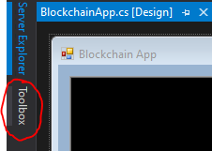
Now ready to have fun Learning by Doing
Customising the UI
1) Add a buttons on the UI: Click Toolbox (on the left side of the screen) and a window will expand, click All Windows Forms or Common Controls, and within the drop-down menu click and drag Button onto the UI. a horizontal tab titled Toolbox should be visible.
2) Now search for a TextBox in the Toolbox
and drag it onto the UI.
Your UI should now appear as shown
on the next slide

Slide 11
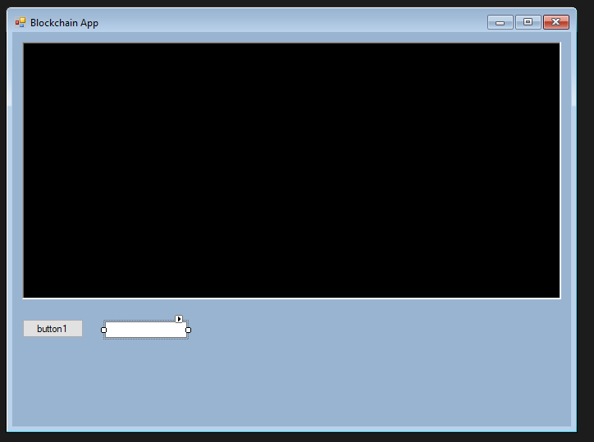
3) Click button1 once to open its properties in the bottom left.
4) Change the button1’s text property to say ‘Print’ instead of ‘button1’.
5) Double click the button and you will be taken to the underlying code, a new function for clicking the button is created after double clicking it.

Slide 12

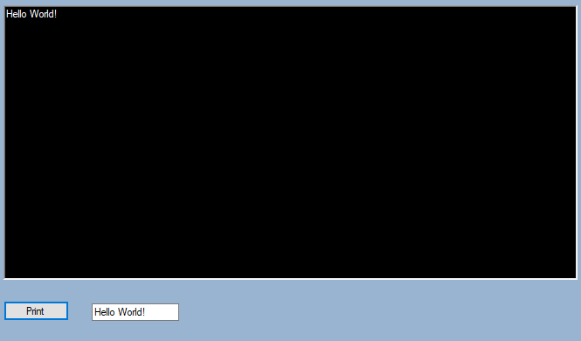
5) Writing some code that takes the text from the TextBox that we have added and prints it to the larger textbox above, when we click the Button.
6)To get the names of the Textboxes you can click them in the UI form, in this case the large black text box is called rich TextBox1 and the smaller text box is textbox
Here is the output

Slide 13
Note: This textbox and button can be removed or re-purposed after this section as you wish.
Now let’s go for it, by starting build blocks, wallets, transactions and mining and validating each block to complete the work each time to build each of the above component we create/add the additional classes needed and then use the relevant Constructors each time and add the additional buttons on the UI to show what we have constructed and test it and save the screenshots for the report.

Slide 14
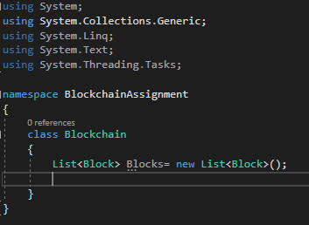
Part 2 – Setting up the Blocks for the Blockchain
1) Right click BlockchainAssignmentAnswer.csproj and click add then new item.
2) Add a new class called Blockchain.cs and another class called Block.cs.
3) A Blockchain consists of a chain of blocks, so add a list variable into Blockchain.cs that holds Blocks.
1. Blockchain.cs code

Slide 15
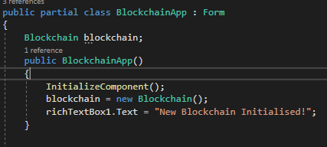
4) Initialise The Blockchain itself either in BlockchainApp.cs or in Program.cs (Main) and pass into the BlockchainApp.cs.
5) Add the following variables to the Block class with appropriate types:
A timestamp, set when the Block is made.
An index; the position of the Block within the Blockchain
Hash of the Block
Hash of the previous Block
2: Initialising blockchain within the form

Slide 16

6) Create a constructor, with two arguments, for a new Block to assign these variables. The constructor should have two arguments, the hash of the prior Block and the index of the prior Block.
7) Alternatively, you can pass the whole previous Block through (In this case you will need to set the access modifiers for the variables to public).
8) Set the Timestamp to the current time (retrieved using Datetime.Now),
9) Assign the previous hash and current index with respect to the given arguments. The hash of the block will be assigned later.

Slide 17

Creating the Genesis Block
1) To generate a hash to complete the assignment of the variables in Block.cs. create a new method in Block.cs that will create the hash.
2) To bundle up all the Block contents, combine the index, timestamp and previous hash and hash the combination, using the hashing algorithm SHA256 to produce a hash each time
3) Copy the SHA256code into your CreateHash method. https://emn178.github.io/online-tools/sha256.html
4: An empty method in C# that should return a String
SHA-256 and SHA-512 are novel hash functions computed with 32-bit and 64-bit words, respectively.

Slide 18
SHA256 hasher = SHA256Managed.Create();
String input = index.ToString() + timestamp.ToString() + prevHash;
Byte[] hashByte = hasher.ComputeHash(Encoding.UTF8.GetBytes(input));
String hash = string.Empty;
foreach (byte x in hashByte)
hash += String.Format("{0:x2}", x);
return hash;
SHA-256 and SHA-512 are novel hash functions computed with 32-bit and 64-bit words, respectively.

Slide 19
4) Now to complete the Block Constructor assign the value of the hash variable in the constructor to the output of CreateHash().
5) To generate a Genesis Block we must create another constructor in Block.cs. This constructor will have no arguments, it will assign the previous hash to an empty string and the index to 0.
6) Create a constructor for the Genesis block in Blockchain.cs following the same steps as done for Blocks build in general but with the values of the two arguments set for the Genesis block as stated in 6 above. This constructor calls the Genesis Block constructor in Block.cs. so that the Genesis Block is added to the Blockchains list of Blocks and is created once the App is started.

Slide 20
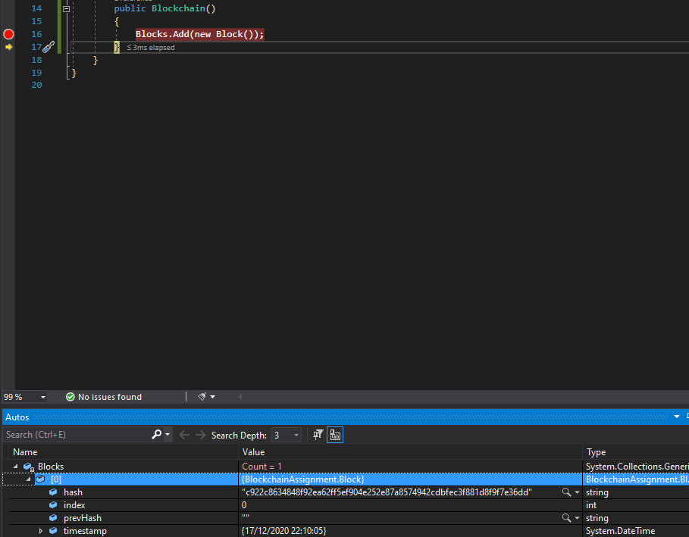
5: An example of debugging in C# that shows the contents of Blocks

Slide 21
Printing a Block to the UI
To verify the blockchain Genesis Block is created, display its variables to the UI through the following steps:
1)Add a new method in Block.cs to return a string containing the Block index, previous hash, hash and timestamp.
2) Add a new method in Blockchain.cs that takes a Block index as an argument, then calls the above method in the chosen block and returns the output.
3) Add a button in the UI that calls the Blockchain.cs method to read a given Block.
4) Print this text to the large black text box. Re-purpose the buttons you made earlier for this purpose. Also, you may want to make a method dedicated to changing the text of richTextBox1, as you may be changing it frequently.

Slide 22
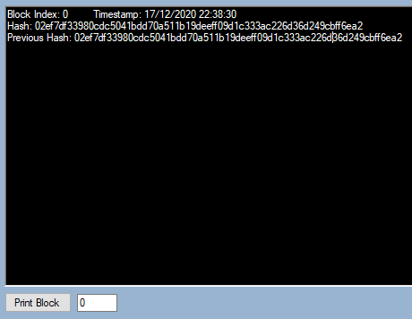
6: The output of the Genesis Block – for now

Slide 23
Part 3 – Transactions and Digital Signatures
3.1 Wallets & Private and Public Key Generation
Blocks used to store any data type to be recorded on the chain but most often used to carry transaction data recording movement of digital currency between people/nodes/accounts (i.e between wallets).
Wallets identity account holders (nodes) in the peer-to-peer network making the blockchain. To build blockchain we must first have client accounts i.e. build wallets
In Blockchain a wallet has two components: an asymmetric key pair: a public key public key (64 characters), and a private key (32 characters).
There are many asymmetric encryption algorithms for generating key pairs; here we will use the Elliptic Curve Digital Signature Algorithm (ECDSA) as used by Bitcoin

Slide 24
Wallets Constructor: Wallet.cs within the Wallet folder, contains the code for key pair generation and validation: Wallet (out String privateKey) – Constructor for a Wallet object. The Wallet object has one variable, public key. The private key is an output parameter.
Example code of constructing a Wallet:
String privKey;
Wallet.Wallet myNewWallet = new Wallet.Wallet(out privKey);
String publicKey = myNewWallet.publicID;
Console.WriteLine(publicKey + "\n" + privKey);

Slide 25
ValidatePrivateKey(privateKey, publicID) – Returns true if private and public key are mathematically related. Returns false otherwise.
CreateSignature(publicID, privateKey, data) – Digitally signs the given data using the private key given. Returns the digital signature.
ValidateSignature(publicID, data, digitalSig) - Confirms that a given signature has been signed by a private key related to the given public key. Returns true/false.

Slide 26
Coding up the wallet build
1. Add a new button to the UI that generates a new Wallet.
2. Add two new text boxes to the UI to display the public and private keys of the wallet
3. Add labels to the UI to distinguish which key is public and private, respectively.
4. Add a button to validate the public and private keys of a wallet n the textboxes (Call the ValidatePrivateKey method to do this)

Slide 27
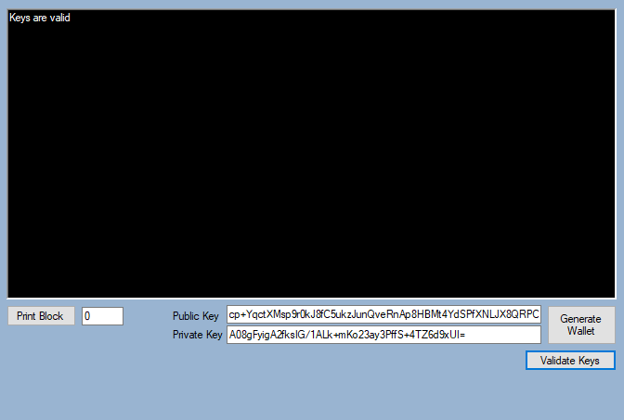
7: An example of key pair generation with validation message.

Slide 28
Setting up Transactions
Now we can send funds between the wallets created so need to add transactions to the Blockchain.
Set up a Transaction.cs class.
Add the appropriate variables you would expect to see in a Blockchain transaction as shown in a example of a transaction from Bitcoin. Accordingly declare the transaction variables and their types in Transaction.cs:# as follows:
Hash – the hash of the transaction and its contents
Signature – the hash of the transaction signed with the private key of the sender
SenderAddress – the public key of the sender
RecipientAddress – the public key of the receiver
Timestamp – the time at which the transaction was made/sent
Amount – the amount of currency being sent to the receiver
Fee – the fee added to the transaction (this will be implemented later)

Slide 29
1) Create a constructor for transaction, accepting arguments for the above variables plus also the sender’s private key but exclude hash, signature and timestamp as the method will generate these.
2) The constructor should assign the arguments to their respective properties, then the timestamp should be set to current time. The transaction should now have a sender, receiver, timestamp, amount, and fee.
3) Use the values of these transaction variables to generate the hash of the transaction
4) Use the SHA256 HashCode made available within BlockchainAssignment.csproj and adjust it to make a method to generate a transaction hash, then assign the hash with the result.
Note that any hash in Blockchain is in hexadecimal meaning that each character in the hash can be one of 16 characters: 0-9 and A-F

Slide 30
1) Sign the tranasction hash with the sender’s private key (this was supplied in the argument of the constructor). You can generate a signature using the static method of Wallet.cs, CreateSignature(), passing to it the sender’s address, their private key, and the hash of the transaction as arguments.
2) Make a method in Transaction.cs that returns the contents of a transaction as a string.
3) Transactions are to move money so as you start generating transactions now is your chance to come up with the name of your own crypto-currency! e.g. “AssignmentCoin”
Note: The private key should not be left in the memory of the transaction instance, so do not save it as a variable.

Slide 31
Generating a pool of Transactions and selecting Transactions from the Transaction Pool to be bundled in Blocks to update the Blockchain.
To generate transactions and then display them to the UI, you require the following new buttons first set up on the UI to display the value of the variables for each transaction so that you can process the transaction. these new buttons are for:
An ‘Amount to send’ label and textbox
A ‘Fee’ label and textbox
A ‘receiver address’ label and textbox
A button to ‘send the transaction,’ once the above fields have been completed
Note: You can re-use the private and public textboxes for this purpose.

Slide 32
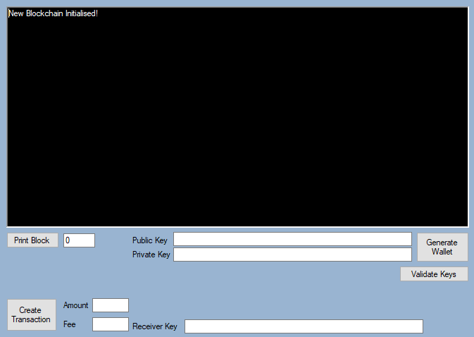
8: New UI for transactions

Slide 33
When the ‘Create Transaction’ button is clicked the following should occur:
Amount, Fee, Public Key, Private Key, and Receiver Key fields are passed through to a new instance of Transaction
The Transaction is generated
The Transaction is printed to the UI large text box

Slide 34
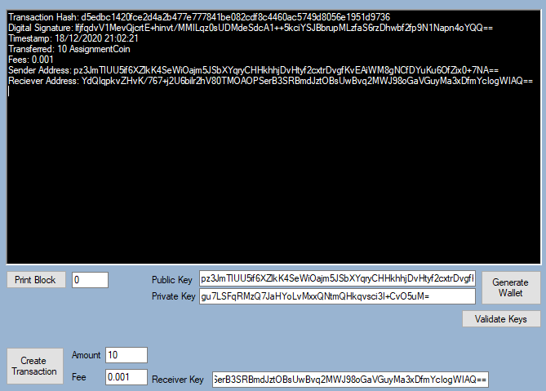
9: Sending some ‘AssignmentCoins’

Slide 35
Note: You may notice there are no checks in place currently to verify if the information being provided is valid. For example, does the sender have the 10 AssignmentCoins to send? -safeguarding against double-spend! - We will build-in the validation later once we have added a wallet balance check code.
A transaction is not confirmed or considered valid until it has been shared with the network and added to the Blockchain. To create the Transactions Pool) to store pending transactions waiting to be included in the next block we proceed as follows:
1) Add a list of transactions to Blockchain.cs class called ‘transactionpool’ or ‘pendingtransactions’.
2) Generate at least about half a dozen transactions and add them to the transaction pool.
3) you can now display all your transactions in the transaction pool

Slide 36
Part 4 – Consensus Algorithms (Proof-of-Work)
Generating new Blocks
By now your developing blockchain should be able to generate a genesis block ( Block #0) and generate transactions but now got to put in place the so-called consensus algorithm to allow your first transactions block of your blockchain (i.e. block #1) to be uploaded to the chain and similarly subsequent blocks linked-up to their precursor blocks.

Slide 37
One Block on its own is not a Blockchain, therefore we need to generate some more blocks; so let’s proceed as follows:
1) Add a button to the UI to enable you to generate new Blocks as you click it.
2) Set up this button, using the Windows Forms and your Block Constructor so that when you click the button it calls the Block Constructor and passes to it the requisite variables from the previous block
Based on our earlier Block building so far and the lectures you should know already what each block that is already on the chain contains and how any follow-on block is inextricably chained to the previous block -
Think how the previous Block Hash is used in the process of creating the next block to ensure the linkage continuum.

Slide 38
One Block on its own is not a Blockchain, therefore we need to generate some more blocks; so let’s proceed as follows:
3) Create a method: GetLastBlock method in Blockchain.cs to get the latest block on the chain. This method can be as simple as return blocks[blocks.Count - 1];
4) Accordingly generate new blocks and add them in the “List<Blocks>” variable in Blockchain.cs).
5) Ensure that the list of Blocks in Blockchain.cs is public or at least there is a public method to add new blocks to the list.
6) Now you can update the UI with the contents of the Block.

Slide 39
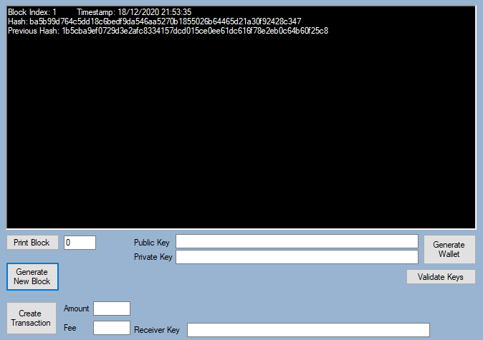
10: The second block – connected to the prior Genesis Block through reference to its previous hash

Slide 40
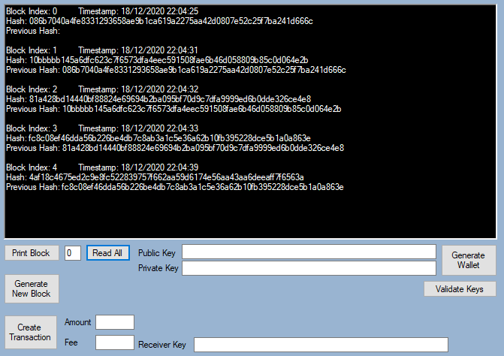
11. Read All “button displaying the five blocks within the chain

Slide 41
Final make-ready steps to complete Block generation ready for the Consensus process:
Adding transactions into Blocks
Now to pack up Blocks that are to carry the transactions as selected from the transaction pool that you set up earlier and now includes the transactions you have just generated, proceed as follows:
1) Add a new data field to Block.cs – transactionList, which should contain transactions.
2) Now need to include the code to add transactions from the transaction pool to newly generated Blocks.
3) Make sure that the constructor of the Block is changed to accept a list of up to say 5 transactions in the arguments (Blocks are typically 1 MB in size so cannot take an infinite number of transactions from the transaction pool, you can add a reasonable finite limit to the number of transactions that each block can take (such as 5 in this mini-blockchain build).

Slide 42
4) Next the hash of the transactions to be contained in the block must be generated based on a special transaction hashing algorithm called the “Merckle Root” as set out later.
5) You may remember that we stated earlier during the Block generation process that once we have generated some transactions, the hash of those transactions that are to be selected by the miner to be contained in the block must be generated first to be hashed together with other variables of the block in generating the overall hash of the block
6) Now you can actually implement the bundling of the transactions to complete block generations by including the hash of the selected transactions (computed using the Merckle Root) with the hash of the other variables of the block to compute the hash of the block ready to be processed through the consensus algorithm to compete with other blocks.
7) Ensure that transactions picked from the transaction pool for each block are removed once the new block is added to the chain using the following suggested code for this:
transactionPool = transactionPool.Except(chosenTransactions).ToList();

Slide 43
8) Edit the Read function of Block to print out the contents of transactions within the Block Making use of the following foreach loop in the Read code
9) Add a button to read all transactions in the pool, to ensure that the code is working as intended.
foreach (Transaction t in transactions) {
output += "\n" + t.ReadTransaction();
}

Slide 44
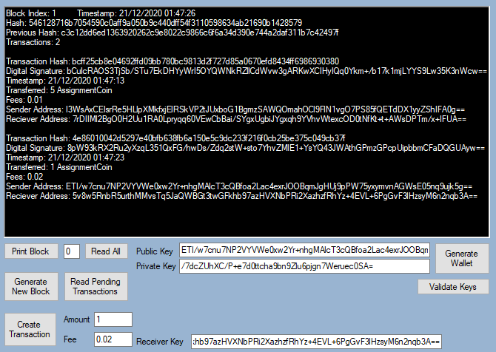
12. Newly mined block with two transactions

Slide 45
Proof-of-Work
In a LIVE Blockchain the blocks are sent to the distributed ledger shared by all nodes in the a peer-2-peer network of that blockchain. The nodes must reach a consensus on how the next Block should be added to update the chain periodically e.g. every 10 seconds or every 10 minutes depending on the operational rules of a particular chain. For this, each miner must use two elements of data provided automatically for miners competing in each block generation cycle, namely:
the nonce (number used only once) and
the degree of difficulty number which is the number of leading zeros that must start the final hash number submitted by each miner attempting to be the first competitor to submit such a hash (The Proof-of-Work hash), and, the hash of the block itself so as to have hers/his block accepted as a valid block and accepted -thus the miner winning the reward.

Slide 46
This final hash is to be arrived at through first hashing the hash of the block with the Nonce and then repeatedly incrementing the nonce by 1 and re-hashing it with the latest hash resulted to-date until arriving at a final hash that has as many leading zeros as the Degree of Difficulty as set by the particular blockchain for that particular block update round.
The winning node (a miner) having achieved the difficulty in shortest time then goes on to shares the Block with the other nodes on the network, these nodes accept the new Block and add it to their identical copies of the Blockchain. In this way the blockchain as universal record of transactions is kept updated. This Proof-of-Work process is the basis of the Consensus method of most early blockchains although there exit other Consensus protocols each with their pros and cons as discussed in the lectures.

Slide 47
Implementing the Proof-of-Work Consensus to update the blockchain with new blocks
1) Add a new data property to Block.cs – nonce (set it to 0 by default).
2) Set a global degree-of-difficulty threshold float that must be satisfied.
3) We recommend selecting a difficulty threshold of either 4, or 5.
4) Include the nonce in the CreateHash() method such that it is included in the process of the composition of the hash.
5) Create a new method Mine() that executes the CreateHash() method within a while loop, which continues until the given hash starts with a number of zeros equal to the degree-of-difficulty.
6) Change the Block.cs constructor to call Mine() instead of CreateHash().
7) Increment the nonce after each failed hashing attempt. Do not increment the nonce after the process has already resulted in a hash that has satisfied the difficulty criteria.
8) Change the Read() method in Block.cs to also return the last value of nonce and the difficulty level the Block was mined at.
(If you implemented this incorrectly your code could get stuck in a while loop. Making use of debug mode (and reducing the degree of difficulty) may help you investigate this problem).
9) Set the difficulty to 4 as a float (we set it as a float to allow for the degree-of-difficulty to be changeable (i.e. a dynamic degree-of-difficulty) if this were to be required.
10) Include the difficulty variable in the hash composition used in CreateHash().

Slide 48
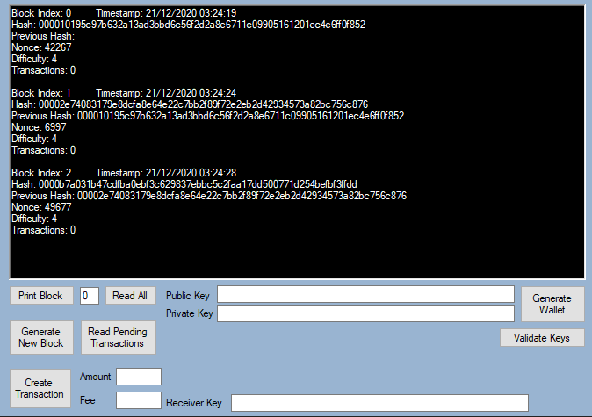
13: Three Blocks mined at a difficulty of 4

Slide 49
Rewards & Fees
In Bitcoin and other Proof-of-Work crypto-currencies the incentive for miners’ PoW comes in the form of fees charged by the miner and paid for by the sender for each transaction and the reward for submitting a valid block (that has satisfied the degree-of-difficulty).
This reward is given as a transaction; the receiver address is the mining node address and the sending node is technically from nowhere (as the currency is generated there and then like a cryptocurrency air-drop) the sender being the ‘Coinbase’. In our implementation this sender’s address should be ‘Mine Rewards’ (because Wallet.cs is configured for reward currency to be sent from ‘Mine Rewards’. You can change this if you reconfigure Wallet.cs. if you wish to set the reward amount to any number or even add conditions to the way rewards are paid as is the casein Bitcoin.

Slide 50
As we have already incorporated fees in our transactions, we are ready to implement rewards and fees for mining nodes; as follows:
1) Add the logic for rewards; it can be fixed, variable, anything you decide.
2) Update the UI code; such that the public address for the miner is sent through to the Block constructor.
3) Before starting to mine the Block, we need to add all new transaction to the transaction list (the pool) used by Block. So, in the constructor of the Block add a new method (before Mine() is called) this method will calculate the reward and total fees owed (for all the transactions in the Block) and create a transaction for the fees and the reward to be paid to the miner if her/his block were to become the wining block
4) Create this new fees-and-rewards payer transaction using the following line of code:
Transaction transaction = new Transaction("Mine Rewards", minerAddress, (reward + fees), 0,"")

Slide 51
5) Configure Wallet.cs to deal with ‘Mine Rewards’ so that a private key does not need to be provided of the rewards payment transaction itself.
6) Now add this new transaction to the transaction list in the Block to be included for payment.
7) Add the reward to the hash composition used in CreateHash()
8) Finally update the read method of Block.cs to print the reward, fees, and the miner’s address {wallet).
9) Print the generated blocks

Slide 52
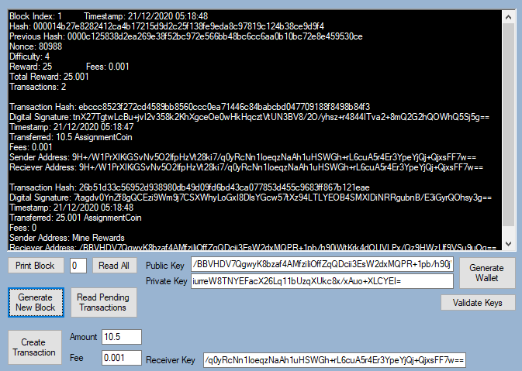
14: Block with rewards implemented. Miner gets a reward of 25.001

Slide 53
Part 5 – Blockchain Validation
So far, we have developed a system that can generate digital keys, generate transactions with signatures, and generate and add Blocks to the Blockchain all of which need to be validated.
Validating the Blockchain Structure
Validating Blockchain Integrity
The component that ‘connects’ the Blocks is the reference to the hash of the previous Block.

Slide 54
Validate that each Block does refer to the hash of the previous Block (Block Coherence, Contiguity)
1) include a new button within the UI that will perform full validation of the Blockchain.
2) Make a method that iterates through the Blocks in the chain and checks the hashes of each block with its previous block to see if they match.
3) This is so that each previous hash reference as is included in each current block does match the actual hash of its previous block (the block located just before it in the chain)
4) If all Blocks pass (match their respective precursor block), then this method must return a success message; otherwise return a failure message.

Slide 55
B) Checking and Validating Wallet Balances
The balance of cryptocurrency existing in a wallet has to be checked before a transaction can be processed; for this:
Include another button in the UI that checks the balance of a given wallet
Include further checks within the transaction generation logic to ensure that the sender has sufficient funds before a transaction can be permitted to proceed (Remember currency is generated through mining so all wallets would start with zero funds in them but to allow transactions to be possible a priming through a Coinbase airdrop can occur).
3) Implement code that goes through all Blocks and searches for transactions involving the wallet you are checking.

Slide 56
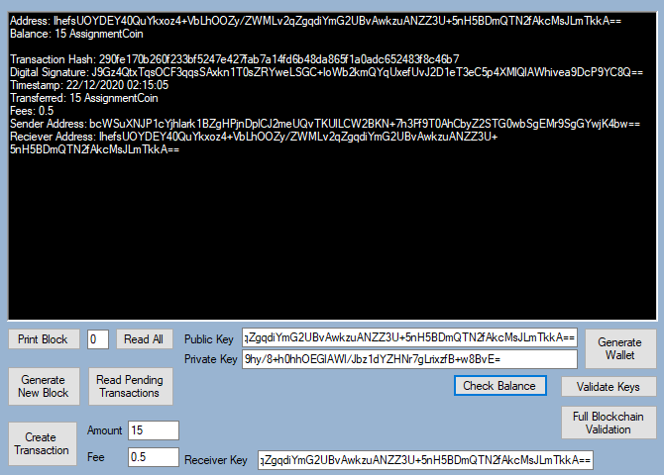
15: Check balance showing the balance of an address along with the transactions in which the address was involved.

Slide 57
The Merkle root algorithm is a scalable and efficient method to encode data on the Blocks in a way that is to protect the integrity of the transactions processing into Blocks by encoding the transactions within a Block to a single hash. Implement this validation protocol through the following steps:
1) Include a new data field within Block.cs, as merkleRoot.
2) Include the Merkle root within the Read() method in Block.cs, make the Merkle root algorithm static, as it will be useful for verification.
3) Include a new method within Block.cs to calculate the Merkle root by combines the hashes of multiple transactions, combined in pairs, iteratively, until only one resulting hash remains after the hash of the latest pair has been included,

Slide 58

Here is the Merckle Algorithm applied to a Block with five transactions( $T_{1}$,$T_{2}$,$T_{3}$, $T_{4}$, and$T_{5}$)
The hash of $T_{1}$ and $T_{2}$ are combined to make $H_{1,2}$
The hash of $T_{3}$ and $T_{4}$ are combined to make $H_{3,4}$
The hash of $T_{5}$ is left untouched for now to make $H_{5}$
Now the hashes $H_{1,2}$ and $H_{3,4}$ are combined to make $H_{1,2,3,4}$
Finally, the hashes $H_{1,2,3,4}$ and $H_{5}$ are combined to make $H_{1,2,3,4,5}$
$H_{1,2,3,4,5}$ is the final transactions hashing result and is referred to as the Merkle root.
Now continue with the implement the Merkle root method in code as follows:

Slide 59
4) Use the method HashTools.cs as made available for you in the HashCode folder to include
comcombineHash(hash1,hash2) to combine the hashes of transactions.
5) Include the merkleRoot data property within the SHA256 hashing method that generates a Block hash. This means that if any transactions have been tampered with, then the Merkle Root will be different from and as a result the hash of the Block will be wrong.

Slide 60
D) Validating Transactions
1) Include checks within the validation method to recalculate the hash of the transactions to arrive at the hash of a given block
2) Compare the resulting hash with a given hash of transaction within a submitted block.
3) include logic using the ValidateSignature(publicKey, hash, signature) method to verify the signature provided in the transaction, to check to see that the transaction has been signed off with the correct private key i.e. to authenticate the person making the transactionTesting the validation

Slide 61
Validating the Validation Method
The integrity of the validation method itself can be verified as follows:
1) Sending a transaction with address that does not have enough funds to support it
2) Sending a transaction and providing an invalid private key
3) Creating a button/method that generates invalid Blocks with incorrect features – e.g., wrong previous hash, wrong hash, invalid transactions within the block.
The above anomalies should all return failure and if not then the validation itself has failed and has to be debugged, corrected and re-tested until it returns correct results for the above tests.

Slide 62
Congratulations!
You got yourself your very own MiniBlockchain.
Please save your screen shots to add to your report towards your first 65% of the CS3BC Coursework Assessment
Now you can check the Coursework Support Hints & Tips in the documents under the CSBC BB pages
Teaching Materials -> Coursework Support Materials -> Blockchain Assignment Development Resources
To add features to your Blockchain to implementstask s 6.1, 6.2, 6.3 towards your hopefully 100% for the CS3Bc Coursework Assessment.

